Slide 1
Predictive Modeling w NLP

Slide 2

The linear combination of TOKENS is the model fit.
outcome
coefficients
constant
error (noise)
Tokens
X1, X2 etc are terms of the DTM.

Slide 3
The linear combination of TOKENS is the model fit.
Y =
box office Revenue
Online Reviews
= (100)(X1 = “love”)
+ (50)(X1 = “great”)
+ (25)(X1 = “good”)
= (100)(DTM “love” = 2)
= (100)(DTM “great” = 0)
= (100)(DTM “good” = 1)
Y = 200+ 0 +25 = $225m

Slide 4
Evaluating a Prediction Model
RMSE- Root Mean Squared Error
MAPE- Mean Absolute Percentage Error
y
y-hat
Actual Values | Predicted/Forecasted
10 | 16
12 | 8
20 | 17
36 | 34
Besides P-Values which is a variable level KPI, and adjusted R-Sq there are two popular KPI for evaluating continuous model predictions.

Slide 5
RMSE
RMSE- Root Mean Squared Error
y
y-hat
ERROR
ERROR-SQ
Actual Values | Predicted/Forecasted | Errors | Squared Errors
10 | 16 | -6 | 36
12 | 8 | 4 | 16
20 | 17 | 3 | 9
36 | 34 | 2 | 4
Mean
36+16+9+4
4
To manually calculate RMSE, work the acronym backwards.

Slide 6

RMSE
RMSE- Root Mean Squared Error
ERROR
SQUARED
MEAN
ROOT
Actual Values | Predicted/Forecasted | Errors | Squared Errors
10 | 16 | -6 | 36
12 | 8 | 4 | 16
20 | 17 | 3 | 9
36 | 34 | 2 | 4
Mean
Square Root
36+16+9+4
$$\sqrt{16.25}$$
4
=4.03
In the same units being measured, tells you +/- the prediction error.

Slide 7
MAE
MAE- Mean Absolute Error
ERROR
ABSOLUTE
MEAN
Actual Values | Predicted/Forecasted | Errors | Absolute
10 | 16 | -6 | 6
12 | 8 | 4 | 4
20 | 17 | 3 | 3
36 | 34 | 2 | 2
Mean of Absolute Errors
6+4+3+2
4
=3.75
Instead of squaring error, take the absolute error. Then take the average among those errors.

Slide 8
MAPE
MAPE- Mean Absolute Percentage Error
ERROR
ABSOLUTE
PCT
MEAN
Actual Values | Predicted/Forecasted | Errors | Absolute | As % of Forecast
10 | 16 | -6 | 6 | =6/16 or 37%
12 | 8 | 4 | 4 | =4/8 or 50%
20 | 17 | 3 | 3 | =3/17 or 17%
36 | 34 | 2 | 2 | =2/34 or 5%
Mean of Percentages
37%+50%+17%+5%
4
=27.7%
Instead of squaring error, take the absolute error. Then divide that by the forecast value. Lastly calculate a mean average of all the percentage errors.

Slide 9
Let’s Practice
Open E_Text_Regression.R

Slide 10

Explanatory Vs Predictive Modeling
Make sure you understand the point of your project
(explanatory or predictive)
Do leaders want to understand a phenomena?
Do leaders want to make accurate predictions about the future?
This impacts how you evaluate the model and even what variables you choose.

Slide 11

If you don’t need explanations…you could try LSA

Slide 12
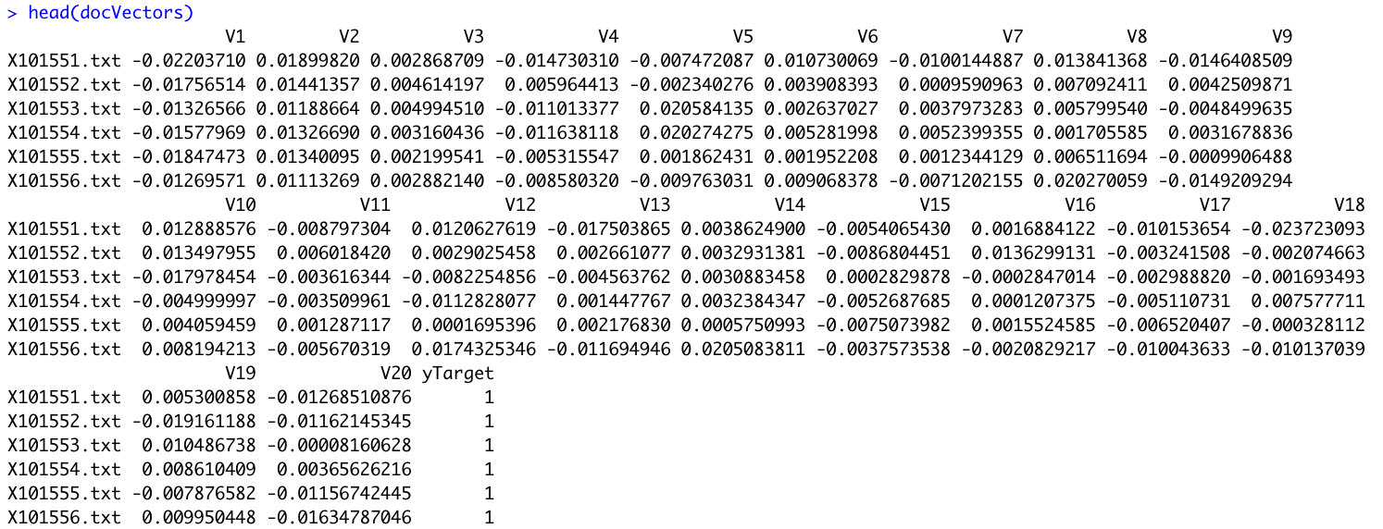
The modeling function usually needs a matrix with both.

Slide 13
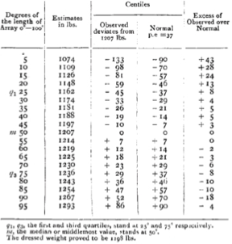
The Wisdom of the Crowd
Prevailing wisdom at the time was that crowds acted irrationally
Riots, mobs, cults
Galton wanted to explore trustworthiness and peculiarities of popular judgment
Galton attended an Ox weight guessing competition at a cattle exhibition
Participants individually guessed a very wide weight range
The median weight was 9lbs (0.8%) off and was better than individual cattle experts.

Slide 14
Random Forests - Classification
Each mini tree acts as a voter from the mob. Each voter is allowed to look at a random group of variables e.g. a mini data set to make its splits.
East
West
East
West
East
East
Vote Tally
East | West
4 | 2

Slide 15
Random Forests - Regression
Each mini tree acts as a voter from the mob. Each voter is allowed to look at a random group of variables e.g. a mini data set to make its splits.
11
8
6
9
12
14
Average
(11+9+8+12+6+14)/6 = 10

Slide 16
How a random forest is really grown.
Draw many re-samples of cases from the data (bootstrap)
For each re-sampled set use a random subset of predictor variables to produce a tree. Some parameters include
Number of trees to grow – dictates the number of re-sampled sets
Number of predictor variables for each tree
Combine the predictions/classifications from all the trees (the entire forest)
Votes are tallied for classification problems
Predictions are averaged for continuous problems
Since it has many weak learners, overfitting is less of a concern. Some trees will get the unlikely outlier value while most won’t.
Since its fitting many hundreds of trees, it takes some time to train a model.

Slide 17
F_lsa_text_regression.R

